Slide 1
Seeing the Impossible Visualizing Latent Variable Models
Dustin Fife
Steven Brunwasser
Ed Merkle

Slide 2
How it came to be...
Balance 1 | Balance 2 | Balance 3 | Balance 4 | Bal 5 | Wobble1 | Wobble2 | Wobble3 | Wobble4 | Wobble5
20 | 10 | 13 | 13 | 18 | 2 | 3 | 2 | 3 | 6
11 | 19 | 18 | 15 | 10 | 7 | 7 | 4 | 5 | 6
17 | 20 | 13 | 20 | 11 | 4 | 5 | 2 | 2 | 7
19 | 11 | 17 | 20 | 20 | 2 | 2 | 3 | 7 | 5
19 | 11 | 14 | 14 | 19 | 4 | 7 | 2 | 4 | 3
12 | 11 | 12 | 20 | 18 | 2 | 4 | 2 | 5 | 5
19 | 13 | 10 | 20 | 15 | 7 | 3 | 4 | 4 | 3

Slide 3
How Can I avoid this in the future?

Slide 4
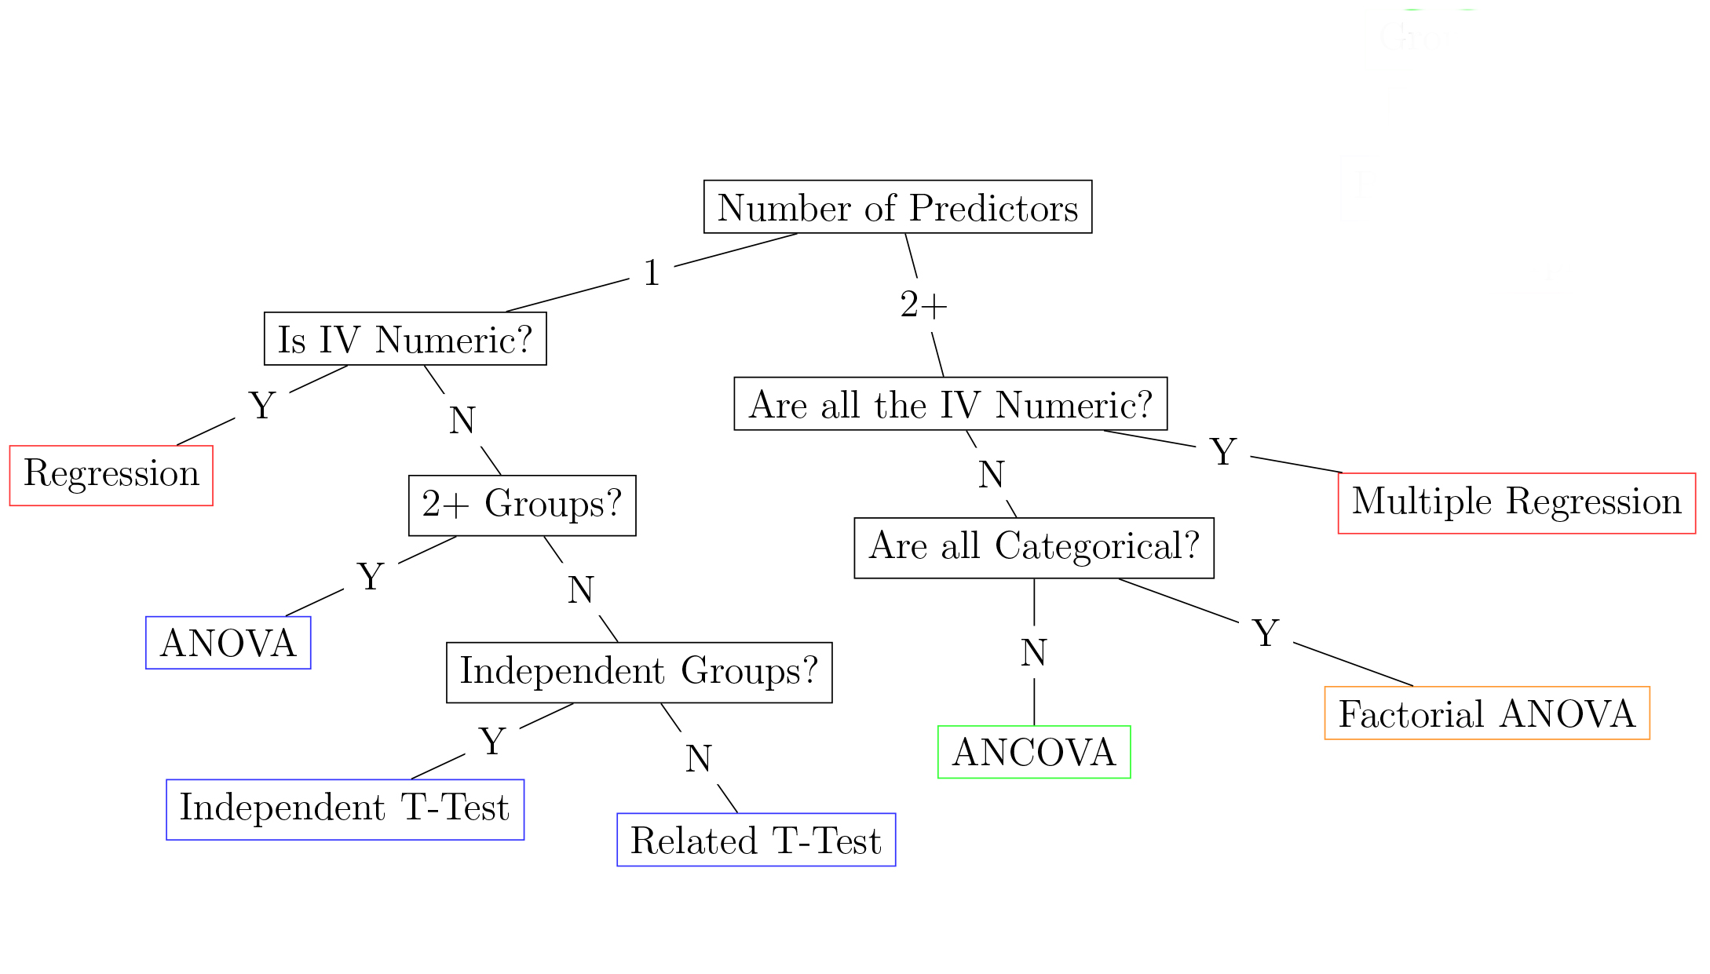

A Different Approach to Data Analysis
Traditional way

Slide 5
A Different Approach to Data Analysis
Traditional way
Sequence of Steps
Unambiguous Decision

Slide 6
So what to do?
First, don't look for a magic alternative to NHST, some other objective mechanical ritual to replace it. It doesn't exist.
-Jacob Cohen

Slide 7
So what to do?
Translation?
First, don't look for a magic alternative to NHST, some other objective mechanical ritual to replace it. It doesn't exist.
-Jacob Cohen

Slide 8
So what to do?
NHST is wrong and you should never use it.
Oh, and there’s nothing else you can do.
So give up.
-(Mistranslation of) Jacob Cohen
I didn’t say that!

Slide 9
Eight Steps
State theoretical hypothesis and decision criteria
Assess psychometrics
Plot univariate distributions
Plot a graphic to match the analysis
Study the residuals
Study parameter estimates/effect sizes
Make a decision based on step 1
Replicate on a new sample
Fife, D. (in press). The Eight Steps of Data Analysis: A Graphical Framework to Promote Sound Statistical Analysis. Perspectives on Psychological Science. https://doi.org/10.31234/osf.io/r8g7c

Slide 10
Eight Steps
State theoretical hypothesis and decision criteria
Assess psychometrics
Plot univariate distributions
Plot a graphic to match the analysis
Study the residuals
Study parameter estimates/effect sizes
Make a decision based on step 1
Replicate on a new sample
Fife, D. (in press). The Eight Steps of Data Analysis: A Graphical Framework to Promote Sound Statistical Analysis. Perspectives on Psychological Science. https://doi.org/10.31234/osf.io/r8g7c

Slide 11
Eight Steps
State theoretical hypothesis and decision criteria
Assess psychometrics
Plot univariate distributions
Plot a graphic to match the analysis
Study the residuals
Study parameter estimates/effect sizes
Make a decision based on step 1
Replicate on a new sample
AND ALWAYS plot raw data
Fife, D. (in press). The Eight Steps of Data Analysis: A Graphical Framework to Promote Sound Statistical Analysis. Perspectives on Psychological Science. https://doi.org/10.31234/osf.io/r8g7c

Slide 15
Eight Steps
State theoretical hypothesis and decision criteria
Assess psychometrics
Plot univariate distributions
Plot a graphic to match the analysis
Study the residuals
Study parameter estimates/effect sizes
Make a decision based on step 1
Replicate on a new sample
AND ALWAYS plot raw data
Which means one cannot follow these steps with SPSS
Fife, D. (in press). The Eight Steps of Data Analysis: A Graphical Framework to Promote Sound Statistical Analysis. Perspectives on Psychological Science. https://doi.org/10.31234/osf.io/r8g7c

Slide 16

Flexplot
formula based
computer decides graphics for you
pair plotting with modeling

Slide 17
Flexplot Examples
regression (dots = raw data, fit = line)
t-test (dots = raw data, fit = bigger dots)
ANOVA
ANCOVA (two versions, with ghost lines)
multiple regression (ghost lines)
mixed models

Slide 18
Visualizing Latent Variable Models
They’re invisible!
Raw data??

Slide 19
A little history
concerned with SPSS
invited a cursory look at data
R was great, but…
steep learning curve
Goal:
make R easier to use than SPSS
but developed under a different paradigm
started writing “wrapper” functions
thus, flexplot was born

Slide 20
Flexplot
flexplot
an R package
with versions in JASP and Jamovi
future release of JASP: engine that produces all graphics
utilizes formula
automates the plotting
follows scientifically-generated heuristics

Slide 21
Flexplot examples

Slide 22
Furthermore…
Raw data should be plotted
Not summaries of data
Why?

Slide 23
Compression
Numeric statistics compress information
That compression is okay if the model is appropriate
But you can’t know if it’s appropriate if all you see are the numbers!

Slide 24
Do you see the problem?
Every statistical procedure must have a graphic
Every statistical graphic must present raw data
but…

Slide 25
Yet there are advantages
Improves encoding
Highlights misfit
Focus on local fit, rather than global fit
I’ve never trusted SEMs because I cannot SEE them

Slide 26
Structural Equation Models are Invisible!
We are modeling relationships between latent (unobserved) variables
in other words, the raw data are invisible!
AND, SEMs are done on covariances
not raw data (except FIML…ish)
so we can’t plot raw data!
Example datasets
jedi_jedi dataset
stats_jedi dataset
report summary statistics
show visual of latent variables

Slide 27
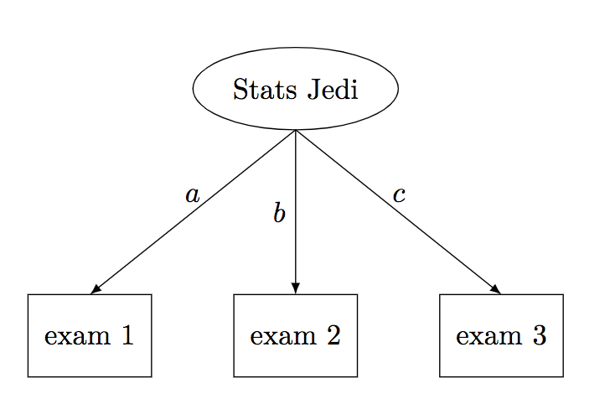
Stats Jedi Example

Slide 28
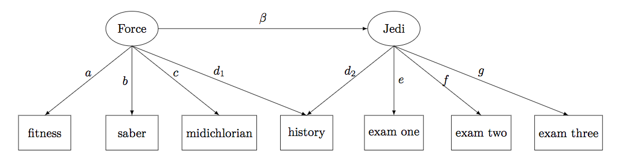
JEDI Jedi Example

Slide 29
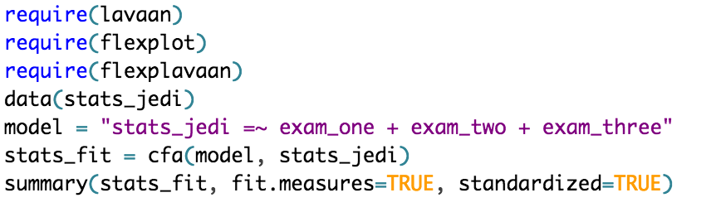
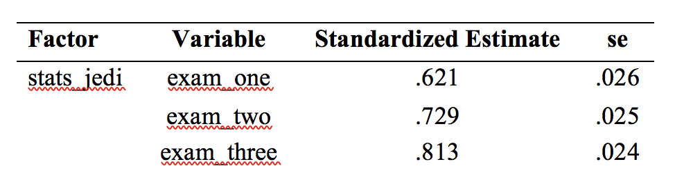
Fit
rmsea < 0.001
cfi = 1
lti = 1

Slide 30
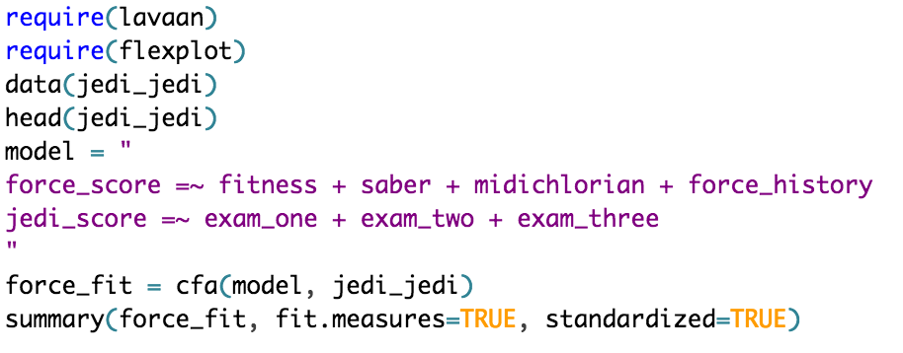
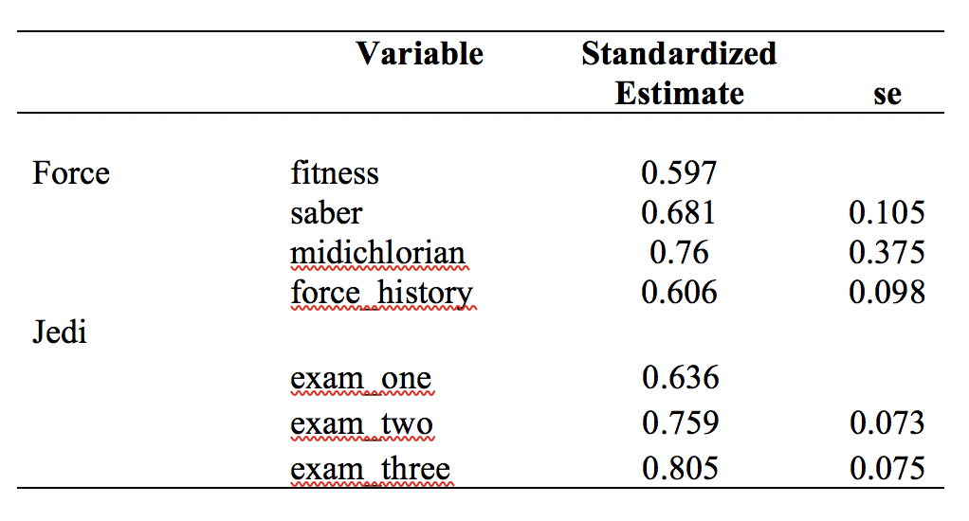
Fit
RMSEA = 0.165
cfi = 0.850
lti = 0.757

Slide 31
Not that people haven’t tried…
Two groups of techniques for visualizing SEMs
Visualizing relationships between latent and observed

Slide 32
Problems…
These assume the model is correct
These assume linear relationships
because they’re based on covariances/means

Slide 33
Visualizing latent scores (Tay, not tay).
compute factor scores for every individual
study relationships between latent variables based on factor scores

Slide 34
What approach do we typically take?
Regression models (e.g., scatterplots)
observed data are the X and Y
we plot the observed data as points
the model is a line (or a large dot or something)
SEM approaches
latent data are the model
the dots are the latent variable
the dots are the model
Let’s get back to the basics
leave the data as the dots
leave the model as the line

Slide 35
Shadow Plots
Plot the items on the x/y axis
The line is the “fit”
or the relationship between x/y, implied by the model
the latent is lurking in the “shadows,” leaving its trace as a line
But how?

Slide 36
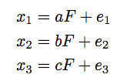
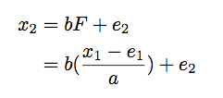
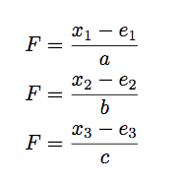
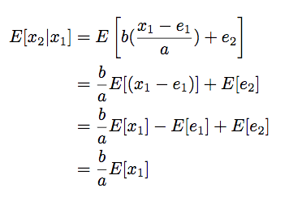
Scary Math
Model-implied equations for variables
Defining x2 in terms of x1
Re-expressed in terms of latent variable
Computing the conditional expectation

Slide 37
Easy as…

Slide 38
In an ideal world…

Slide 39
Not so fast!

Slide 40
Why
SEMs “correct” relationships for unreliability
The fitted line is what we would observe with perfect reliability
But we don’t have perfect reliability!

Slide 41
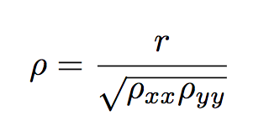
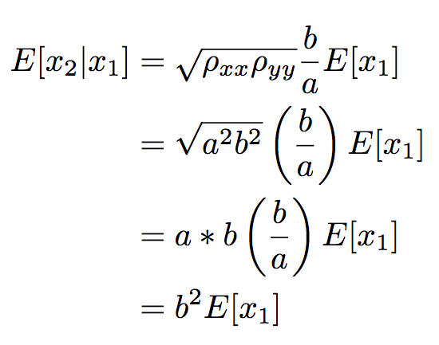
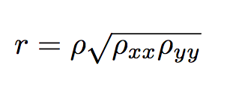
Danger!
Standard correction for unreliability
Plug it in to the previous equation
“Uncorrected” correlation

Slide 42
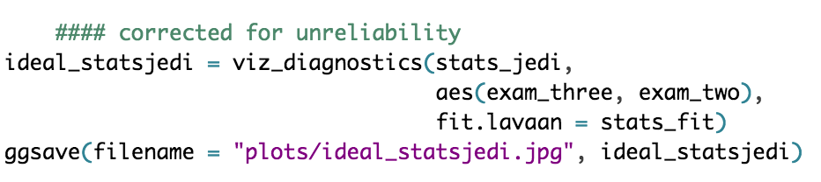
And now we get…

Slide 43
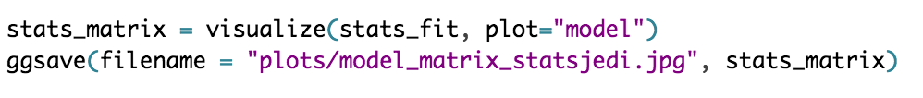
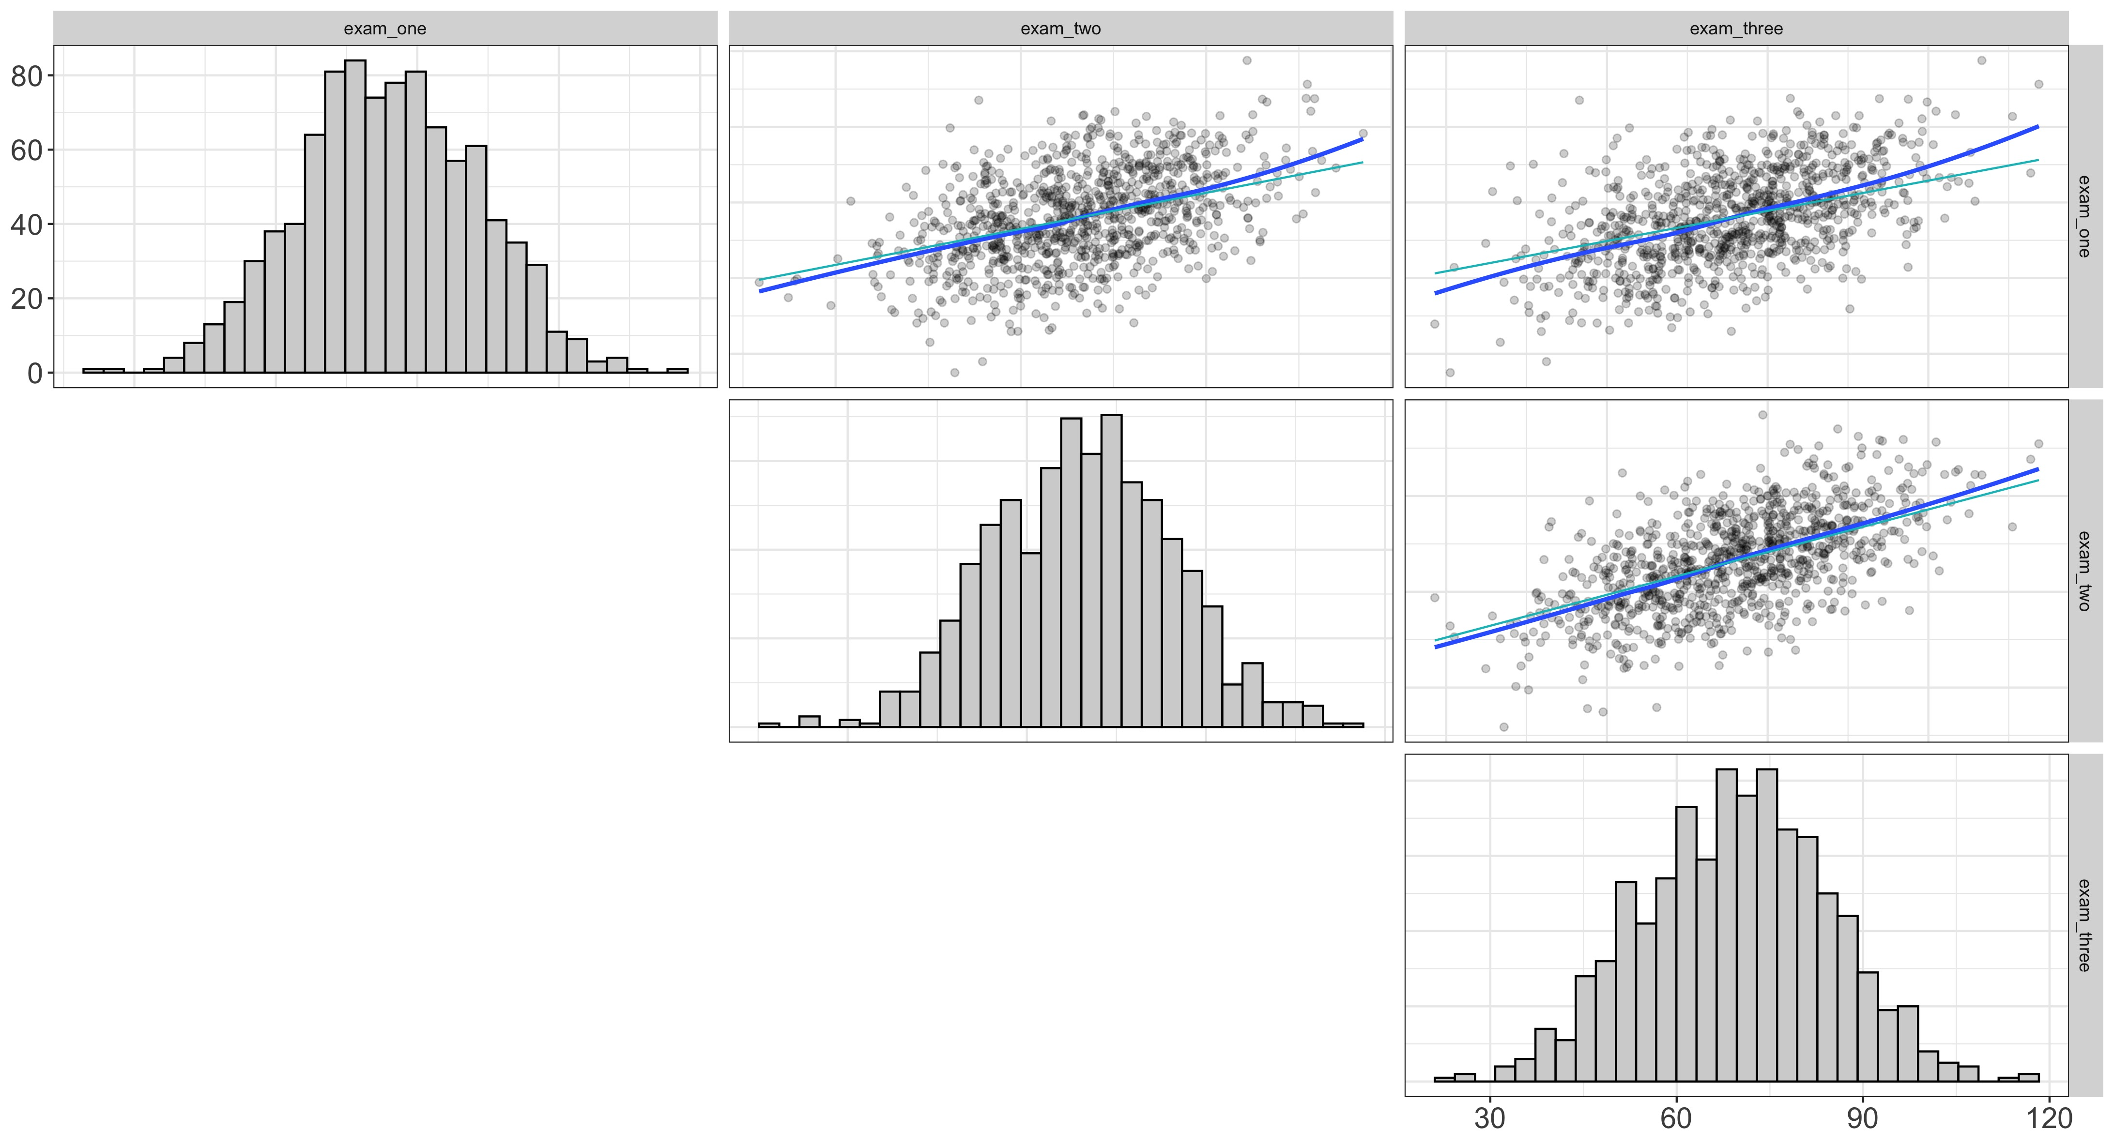
Or see them all…

Slide 44
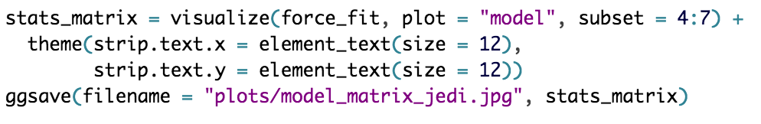
Or see them all…

Slide 45
Shadow plots
Advantages
good diagnostic tool
if the line ain’t going through the data, you know there’s misfit
highlights local misfit
easy to interpret
just standard regression
Disadvantages
may mask misfit
doesn’t improve encoding for the entire model
the math will fail if models are nonlinear

Slide 46
We can also do residual plots
Remember what a residual is
What remains of the DV after we’ve removed the (linear) effect of the IV
geometrically…

Slide 47
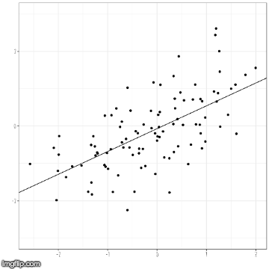
What is a residual?

Slide 48
Disturbance Dependence Plots
Shadow plots give us a “fit”
We can then subtract out the fit to get residuals
but we call them disturbances in SEM
we should have no relationship left
And for our data?

Slide 49
Stats

Slide 50
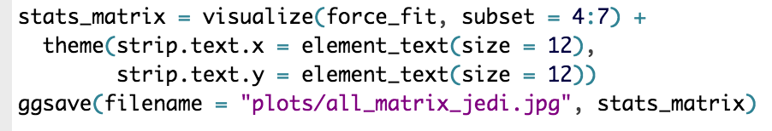
JEDI

Slide 51
Substantive Conclusions
Stats dataset fits quite well
all exams seem to be measuring the same thing
JEDI dataset has some problems
we’re consistently underestimating the relationship between force_history and the three Jedi exams
this suggests we should probably add a crossloading
boy, wouldn’t it be nice if we could visualize the fit of BOTH models??

Slide 52
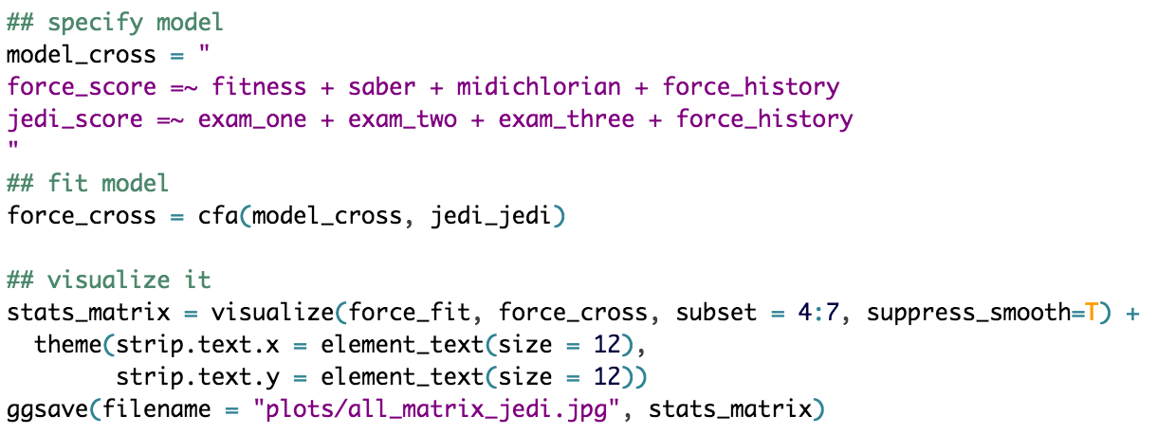
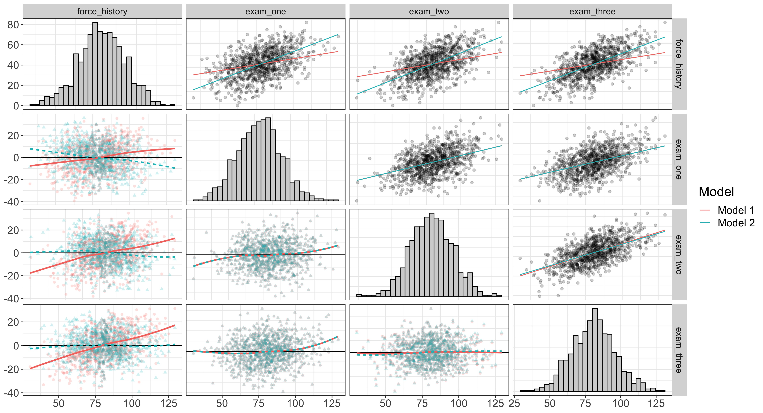
By golly, we can

Slide 53
Visualizing the measurement model
We have four variables
three observed
one latent
That’s a four dimensional plot
But let’s transform the data to long format
but first we transform the scale

Slide 54
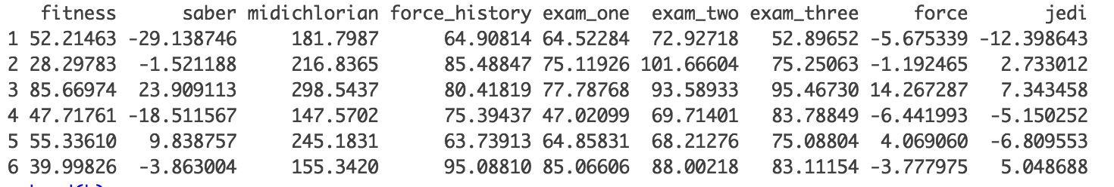
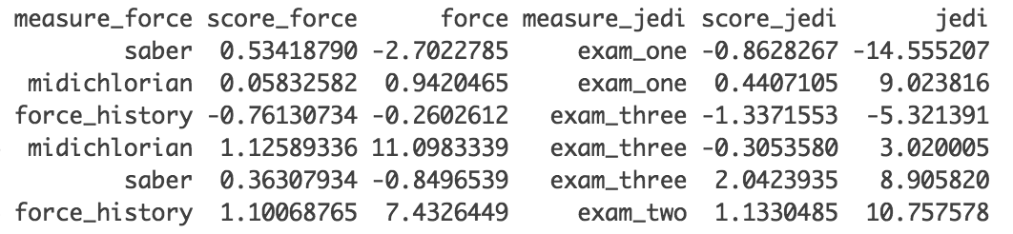
Wide to Long Format

Slide 55
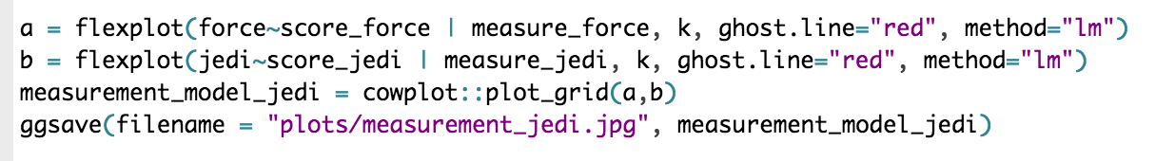
Flexplot

Slide 56
Nonlinear Models
These plots work great if the relationships are linear
But what if they’re not?

Slide 57
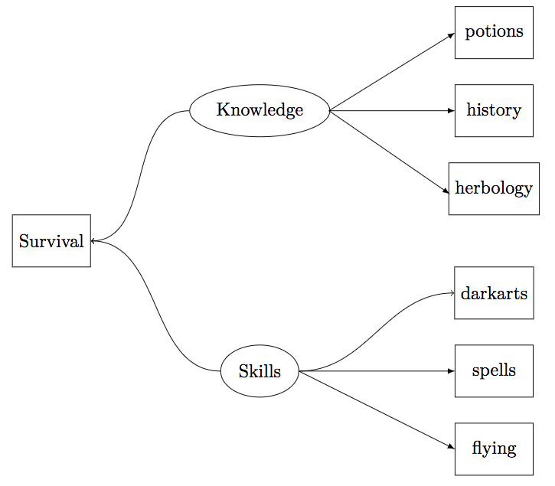
Example data
Hogwarts survival dataset
Nonlinear relationships between:
knowledge and survival
skills and survival
skills and darkarts

Slide 58
Problem
SEMs assume linear models
Can do a categorical model, but they suck
Wouldn’t it be nice if you could explicitly state each path?

Slide 59
Bayesian SEM
Much more flexible than regular SEM
Works with raw data
Able to estimate models regular SEM cannot
Naturally computes latent variables
But…

Slide 60
As of now…
There’s no general solution for visualizing these models
The implied model will depend on how the variables are related
So, I have to do more math ☹

Slide 61
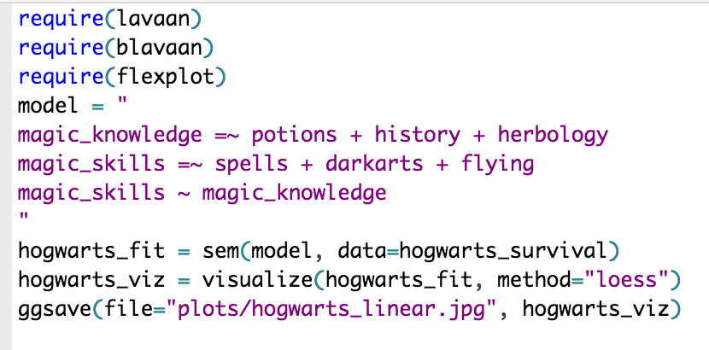
Naïve analysis

Slide 62
Naïve analysis

Slide 63
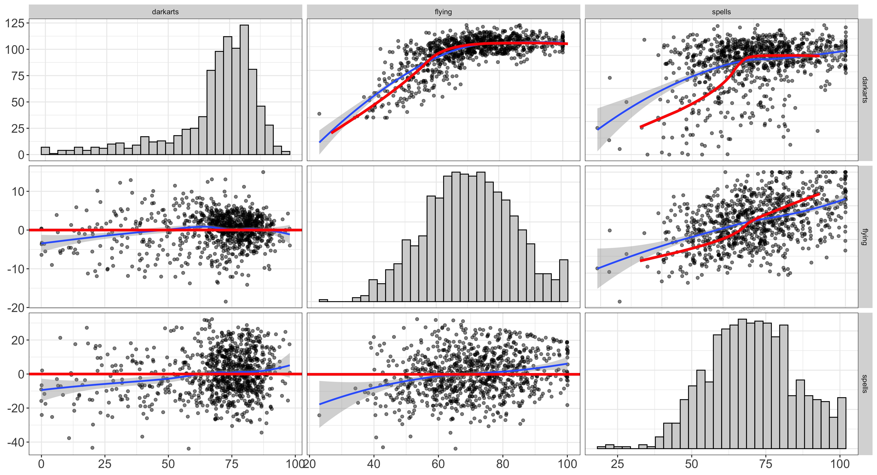
Let’s fit a Bayesian Model

Slide 64
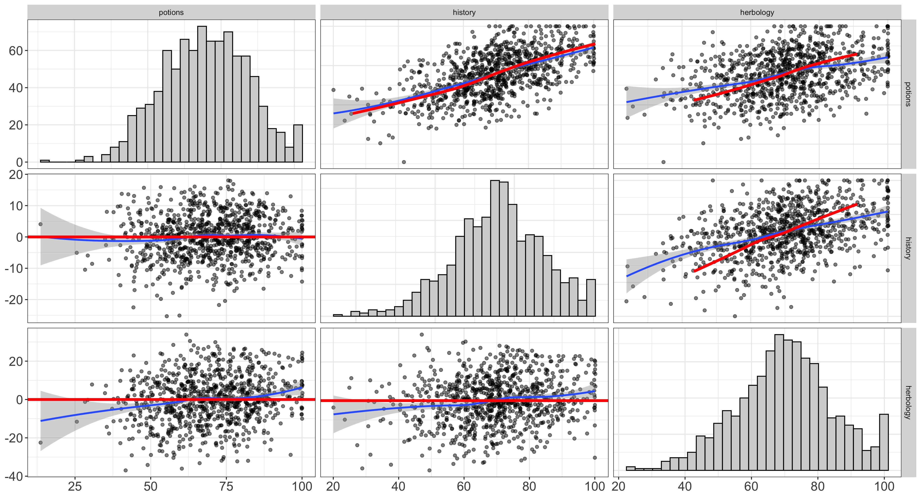

Slide 65
While that’s running…
Let’s review the math here.

